Slide 1
Welcome to the HAPP Internship Orientation
For students enrolling in happ 470 in SPRING 2020

Slide 2
Getting Ready for the Internship
Congratulations!
You are on your way to enrolling in HAPP 470!
This presentation contains all of the information that you will need to complete your online Student Information Sheet.
At the conclusion of this session, please go to the Internship Placement Tracking website at www.runipt.com to update your Student Detail page and Student Information Sheet – including your resume and letter of introduction.
Login information will be forthcoming.

Slide 3
Please Note: Only complete packages will be processed. Please make sure that you are eligible for HAPP 470 and that your online information is complete by using the checklist below:
_____ Student Detail Page (do not include a picture)
_____ Student Information Sheet
_____ Current Approved Resume
_____ Letter of Introduction

Slide 4
Internship Process – Timeline for Spring 2020
Mid-October
The Internship Coordinator meets with interested rising seniors and seniors who are planning to enroll in HAPP 470 in the Spring semester via posted Internship Orientation sessions. During these sessions, students learn the steps in the internship process, receive instructions, and learn about the requirements of the internship course. Attendance at one of the sessions is required for enrollment in the internship course.
Mid- to Late October
Following receipt of login information, students complete the Student Information sheet, draft a resume, and draft a letter of introduction.
Materials must be submitted by November 1. Failure to submit a complete package may result in a delay in enrollment in HAPP 470.
Mid-October to Mid-November
Students’ materials are reviewed for enrollment eligibility.
Students meet individually with the Internship Coordinator to review their applications, discuss interests and learning needs, and identify possible internship sites. Student interests will be considered and there will be a significant attempt to match students with desired and appropriate settings.

Slide 5
Internship Process – Timeline (cont.)
Mid-October – Mid-December
Students are provided with recommendations for potential internship sites.
Internship Coordinator generally contacts the sites and communicates with preceptors and students. Students may be asked to contact certain sites.
Prospective preceptors are simultaneously sent letters via email informing them of the student(s) being recommended. The preceptor is also sent a copy of the potential student’s resume and the student’s letter of introduction.
Interviews occur to provide students and preceptors the opportu­ni­ty to meet, discuss the kinds of assignments and learning experiences offered by the agency, and to clarify expectations.
After the interview, the student should contact the Internship Coordinator to share thoughts about the experience. The student should also send a thank you to the prospective preceptor. Students are also encouraged to contact the Internship Coordinator after the inter­view if they have any problems or reser­vations regarding the potential internship site.
The Internship Coordinator may also request that the preceptor, as a representative of the internship site, completes the Internship Contract.
All internships are required to be 208 hours and to be in accordance with start and end of semester dates.

Slide 6
Timeline for Spring 2020 Internships
Students work on documentation – through late October
All documentation is due November 1
Materials are reviewed – through mid November
Students meet with Internship Coordinator – through mid-November
Interviews and meetings with Preceptors – mid-October through mid-December
Students and Preceptors finalize the internship plan – through January 2020

Slide 7
Exceptions
Some sites have asked for interns who can work the legislative session which begins in January and lasts through mid-April (an ongoing April 10). Do not request these sites if you cannot begin your internship in January.
Other sites would prefer an early January start date for other reasons. This can be discussed during our one-on-one meetings if you are interested in those sites.
You will not have to register for January (so no extra tuition payment) if you are interested in any of these sites.

Slide 8
Calendar
Approximately 16 hours per week for a total of 208 hours during the semester. Schedules are negotiated with the preceptor around your other coursework.
Hours do not begin until the first day onsite and during the semester of enrollment.
Hours are not earned if the agency is closed (snow days, holidays, etc.).
All students are required to remain at their internship site throughout the entire semester.
Even if hours are complete, students must work at the agency until the last day of the semester.

Slide 9
Logging on to IPT Go to www.runipt.com Click on Forgot Your Username or Password?

Slide 10
Logging in to IPT: Enter UMBC email address

Slide 11
Please use your UMBC email and password for IPT!

Slide 12
Logging in

Slide 13
IPT Homepage: Please click on Student Detail

Slide 14
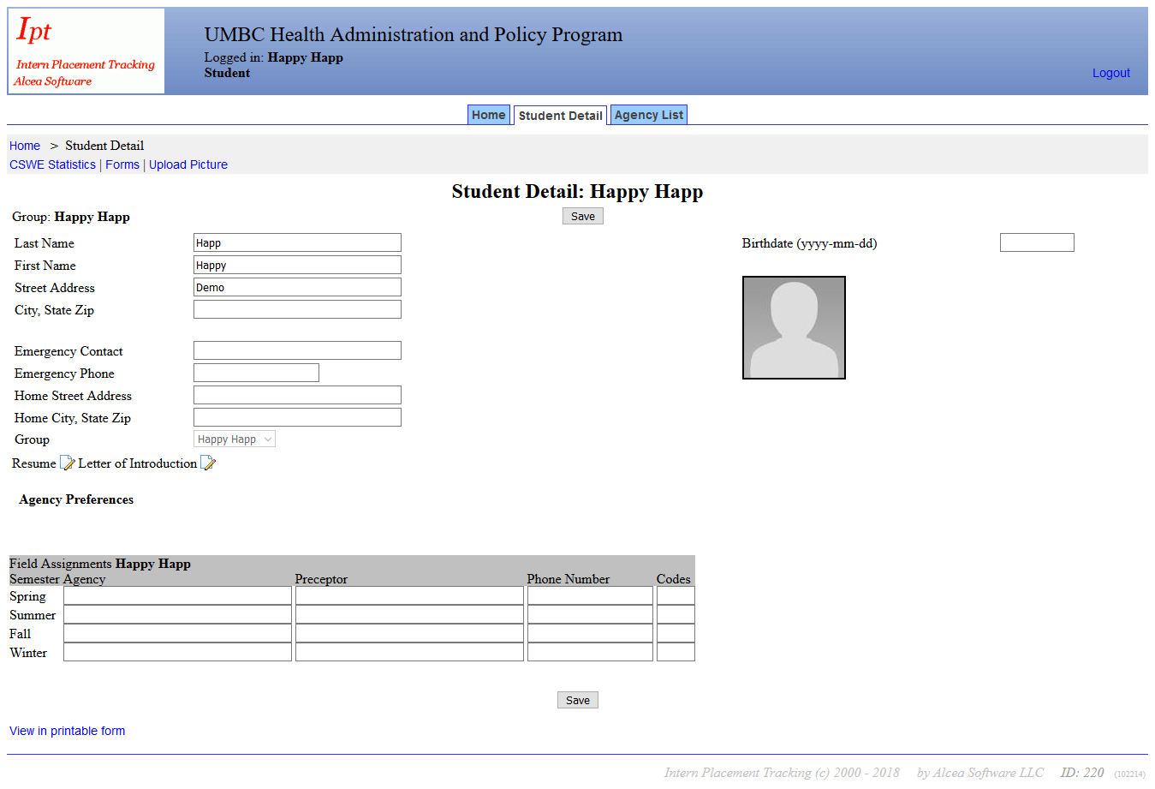
Complete Student Detail Page: No Pictures Please!

Slide 15
Completing SIS: Hit Save, Click Home, Then Go to My Forms

Slide 16
To complete Student Information Sheet, click on “View”

Slide 17
Complete the Student Information Sheet

Slide 18
Resume Guidelines and Tips
The primary purpose of the pre-internship resume is for you to introduce yourself to potential future preceptors.
Resumes must be well-written and free of grammatical, punctuation, and spelling errors.
Action verbs are needed to describe work/volunteer experience. To locate action verbs, please refer to the following link: http://www.quintcareers.com/action_skills.html

Slide 19
More Resume Tips
The average review is 15-30 seconds
Resume should be no longer than one page
Margins should be no more than one inch
Do not use fancy fonts; fonts should be 12 point if possible and preferably a serif font like Times New Roman
Use consistent formatting for headings and dates
Do not use sentence or paragraph formatting
Limit use of abbreviations
Do not lie, exaggerate or use clichés (i.e., “out of the box thinker”)
Put your actual GPA if 3.0 or greater only; do not round up
Leave out personal information
Do not list references
Do not include high school information
PROOFREAD YOUR RESUME

Slide 20
Sample Resume Format

Slide 21
Letter of Introduction and Tips
This letter introduces you to a potential preceptor and is their first impression of you.
This letter allows you to write about your interests and skills s and relate them to expertise needed in the field.
It is important that the letter is well written as it provides a sample of your writing skills and shows the preceptor that your are invested in demonstrating your interest and commitment to your field of study.
The letter of introduction should:
Be no more than one single spaced page
Avoid redundancy and wordiness
Use the same paper as your resume (in case you are asked to bring a paper copy to an interview)
Not have any TYPOS
Have your signature in ink between your close and typed name (if using a paper copy).
Be PROOFREAD before submission

Slide 22
Letter of Introduction Template
Your Name Your Complete Address City, State Zip
Date
This letter of introduction is specifically designed to be used for your internship and may be sent directly to prospective preceptors. Please consider other resources for future cover letters. Since you do not know where you will be accepted for an internship, broadly address your interests in the field and your skill set. Keep your discussions concise!
Dear Prospective Preceptor:
I am currently enrolled in the undergraduate Health Administration and Policy Program at University of Maryland, Baltimore County. There are several areas of study in our program and the track that I have focused on is ____________ because ________________. I am hoping that the internship is, for me, a way to increase my competency through using the knowledge and skills that I have gathered while at UMBC so that I can learn firsthand what it is like to put theory into practice. I am excited to have the opportunity to put what I have learned to work.
My interest in __________________ stems from ____________________, and as I have continued my education in this area, I have found ____________________________. I would be honored to be able to expand on and practice the concepts, instruction, and principles that I have gathered through my academic career by completing an internship with your institution. I look forward to enhancing and applying the skills I have learned, while attaining new ones.
Enclosed, you will find my resume. I appreciate the time you have taken to consider me for a position with your agency, and look forward to meeting you soon.
Sincerely,
Your signature
Your name

Slide 23
Resume and Letter of Introduction
Your letter and resume are the most important parts of your package and can affect whether an agency agrees to interview you or not.
Be prepared to discuss your letter and resume (and probably make corrections) during your meeting with me.
To schedule an appointment, click here.

Slide 24
Final Information
All required documents must be complete and submitted by NOVEMBER 1 for sPRING 2020.
Late submissions will not be considered until all on-time submissions have been finalized.
Further Questions?
Contact:
Professor Meryl Cozart at 410-455-2060 or mcozar1@umbc.edu or
Melissa Cox at mrose4@umbc.edu

